Slide 1

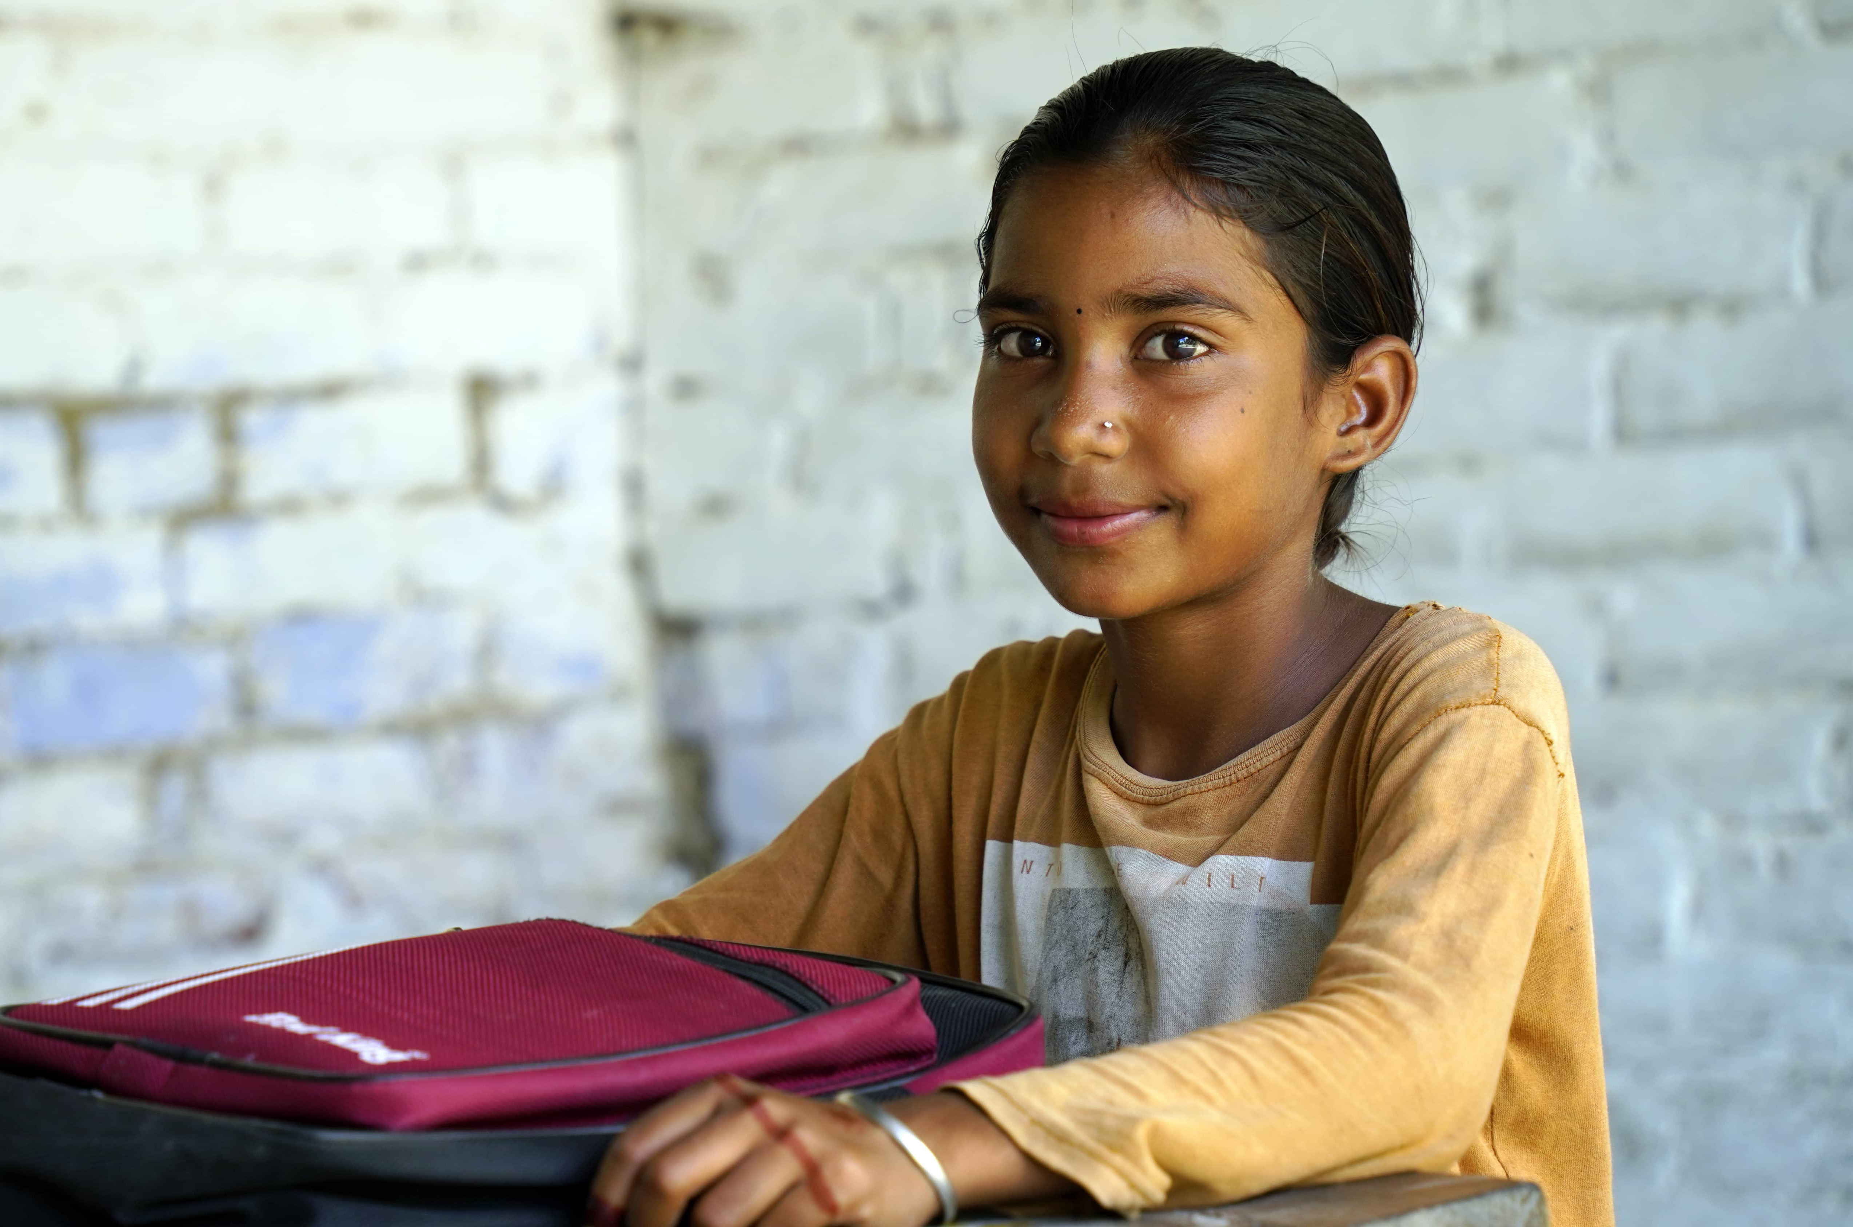
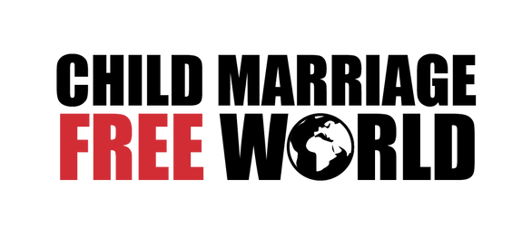
CHILD MARRIAGE FREE WORLD
YOU CAN ADD YOUR LOGO HERE
childmarriagefree.world

Slide 2
WHAT IS CHILD MARRIAGE?
childmarriagefree.world

Slide 3
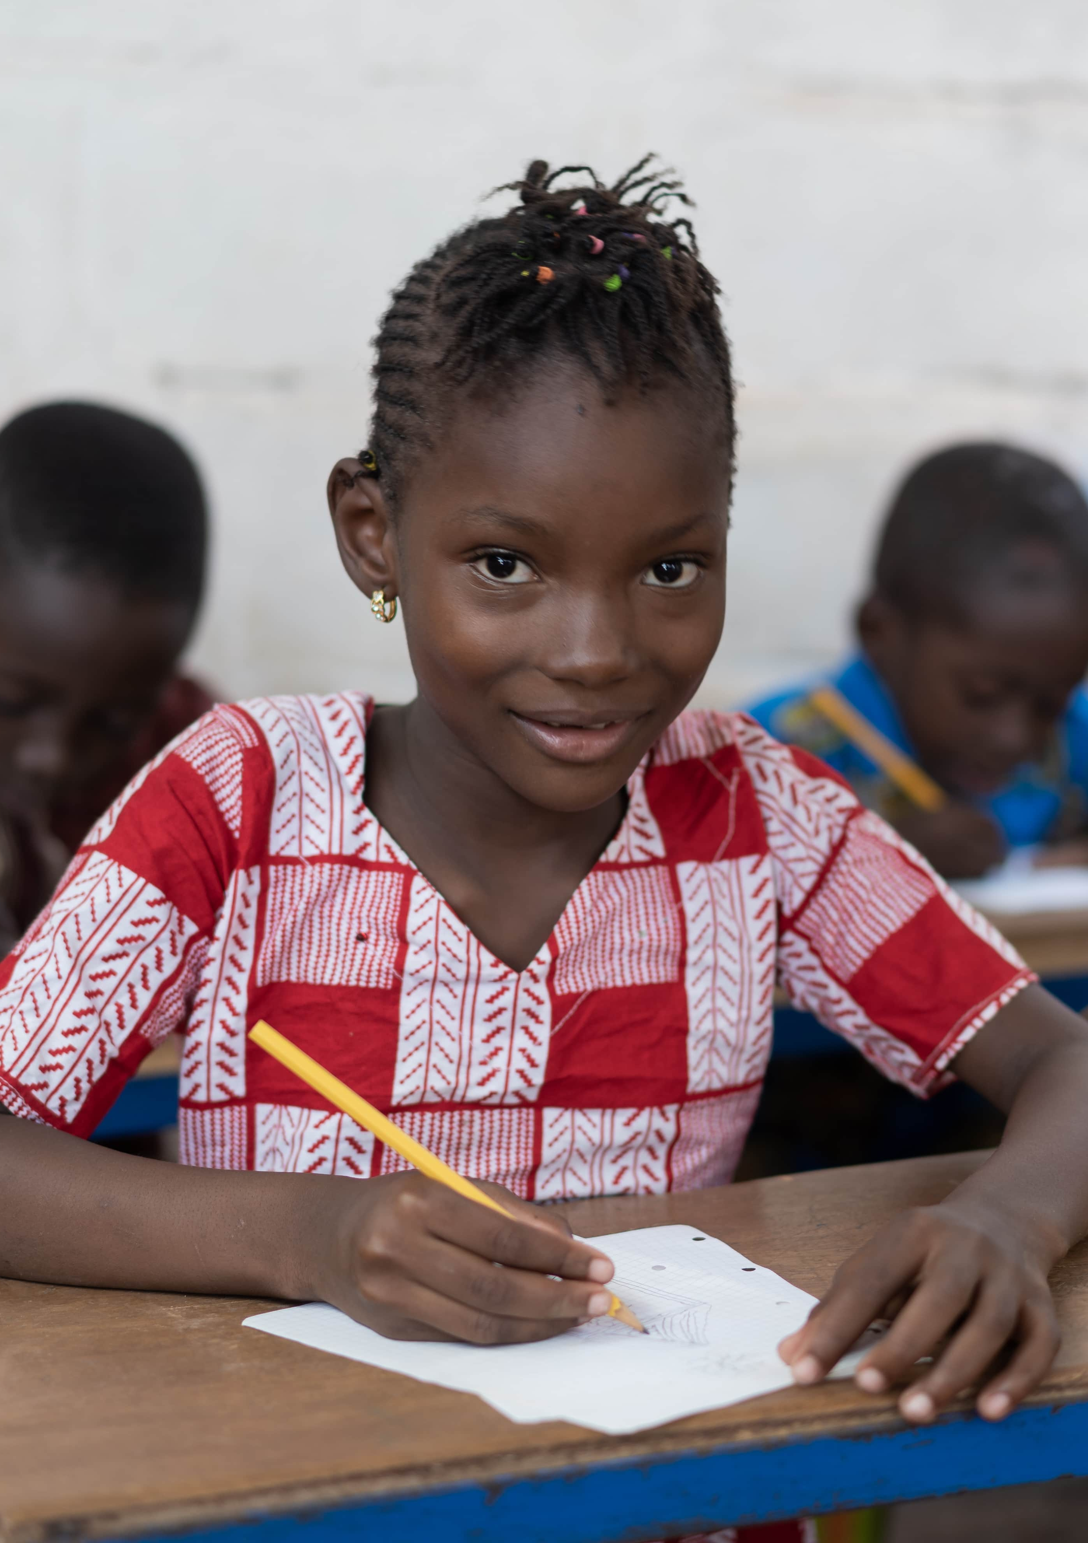
WHAT IS CHILD MARRIAGE?
Child marriage is a formal or an informal union where one or both people are under the age of 18.
Child marriage is much more likely to happen to girls than to boys. An estimated 640 million women alive today were married before their 18th birthday, compared to 115 million men.
Worldwide, one in five young women were married as children, many aged 12, 13, and 14.
Child marriage is reducing slowly, but in some parts of the world, it is increasing among girls from poorer backgrounds.
Child marriage is a violation of rights and a form of violence against girls (or gender-based violence).
childmarriagefree.world

Slide 4
WHERE DOES CHILD MARRIAGE HAPPEN?
childmarriagefree.world

Slide 5
WHERE DOES CHILD MARRIAGE HAPPEN?
Child marriage happens in every region of the world, but to varying degrees.
In sub-Saharan Africa, 30% of young women were married as children. However, some countries in the region have much higher rates than others - for example, in Niger the rate is as high as 76%, compared to Rwanda (6%) and South Africa (4%).
Overall, India is home to a third of all women (of all ages) worldwide who were married as children.
Where you live in a country matters: girls who live in rural areas are more likely to be married as children, compared to girls who live in towns and cities.
childmarriagefree.world

Slide 6
IS CHILD MARRIAGE LEGAL?
childmarriagefree.world

Slide 7
IS CHILD MARRIAGE LEGAL?
Although most countries have a legal age of marriage set at 18, many have exceptions which allow legal child marriage.
The most regular exceptions include having the consent of parents or guardians, getting permission from a judge or government official, and the legal recognition of marriages conducted under cultural or traditional practices.
Fewer than 40 countries around the world set the legal age for marriage at 18 with no exceptions.
childmarriagefree.world

Slide 8
WHAT ARE THE CAUSES OF CHILD MARRIAGE?
childmarriagefree.world

Slide 9
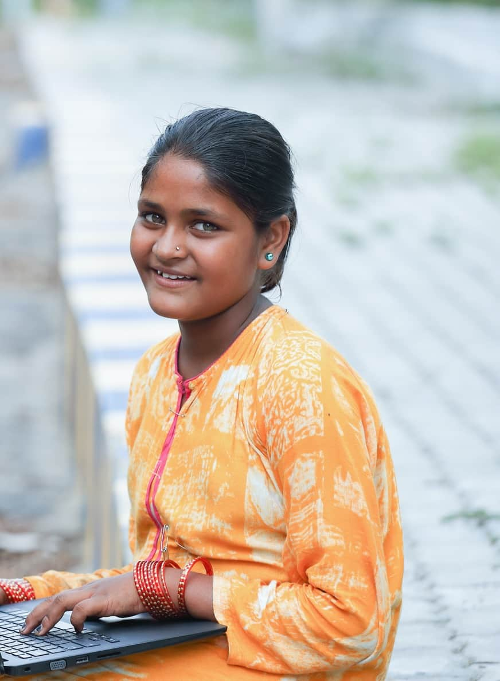
WHAT ARE THE CAUSES OF CHILD MARRIAGE?
Gender inequality is a main cause of child marriage. This is the discrimination against women and girls usually based on the differences between genders, like physical and biological differences, and differences in development and ways of thinking.
Gender inequality is also driven by cultural and societal beliefs that girls are inferior or less valuable than boys.
Poverty is another major cause of child marriage: girls who are from the poorest families are much more likely to be married as children than girls who are from the wealthiest families.
childmarriagefree.world

Slide 10
WHAT ARE THE CAUSES OF CHILD MARRIAGE?
Child marriage also causes poverty: girls are married off early and do not complete their education, making them less likely to be able to get decent work later in life. Daughters of girls who were married as children are also likely to be vulnerable to child marriage, continuing the cycle of poverty.
Living in an area where there is conflict, or which is vulnerable to climate disaster impacts also makes girls more vulnerable to child marriage - this usually happens because parents believe their daughters will be protected from violence if they are married.
Weak laws and government systems: even if the law states that the legal age of marriage is 18 with no exceptions, governments have to spend money to make sure that the law is enforced. They must also provide services which stop girls getting married - such as child protection, or access to safe, free education so that girls are able to go to school.
childmarriagefree.world

Slide 11
WHAT ARE THE IMPACTS OF CHILD MARRIAGE?
childmarriagefree.world

Slide 12

WHAT ARE THE IMPACTS OF CHILD MARRIAGE?
Child marriage denies girls many of their basic human rights, and it puts their health, education, and wellbeing at risk.
If girls who are married used to be in school, child marriage usually ends their formal education. Not going to school limits girls’ ability to understand their rights or to learn about the law and stops the development of their learning and skills.
When a girl enters a marriage, she usually ends up taking on many hours of household chores for her husband and his family. This means child marriage forces girls to become child labourers.
In societies where child marriage occurs, physical violence against women and girls by their husbands is more likely to happen. This is because of the power dynamics between a girl and a husband who is usually an adult, and likely to be much older than her.
childmarriagefree.world

Slide 13
WHAT ARE THE IMPACTS OF CHILD MARRIAGE?
Child marriage also makes girls vulnerable to sexual abuse and rape. Usually, child marriages occur when a girl is below the legal age of consent for sexual relations, which would mean that a husband having sex with a wife under this age is rape. However, very few countries make sexual relations between an adult man married to a child illegal.
When a married girl becomes pregnant, her health is put at risk. Her body may not yet be developed enough to cope with pregnancy, creating a higher chance of health complications, and even death as a result of early childbirth or complications related to childbirth. Early childbirth also risks the health and survival of the baby.
When girls are married and are denied their rights, especially to education, their ability to ensure their own children receive their rights is limited.
childmarriagefree.world

Slide 14
HOW CAN WE END CHILD MARRIAGE?
childmarriagefree.world

Slide 15
TAKE THE PLEDGE: HANDS UP TO END CHILD MARRIAGE
childmarriagefree.world

Slide 16

I will not stay silent. I pledge to do all I can to end child marriage in my country and the world.
I will:
Complete school as I have the right to education
Decide for myself as an adult who I marry
Protect other children by safely reporting child marriages.
childmarriagefree.world

Slide 17
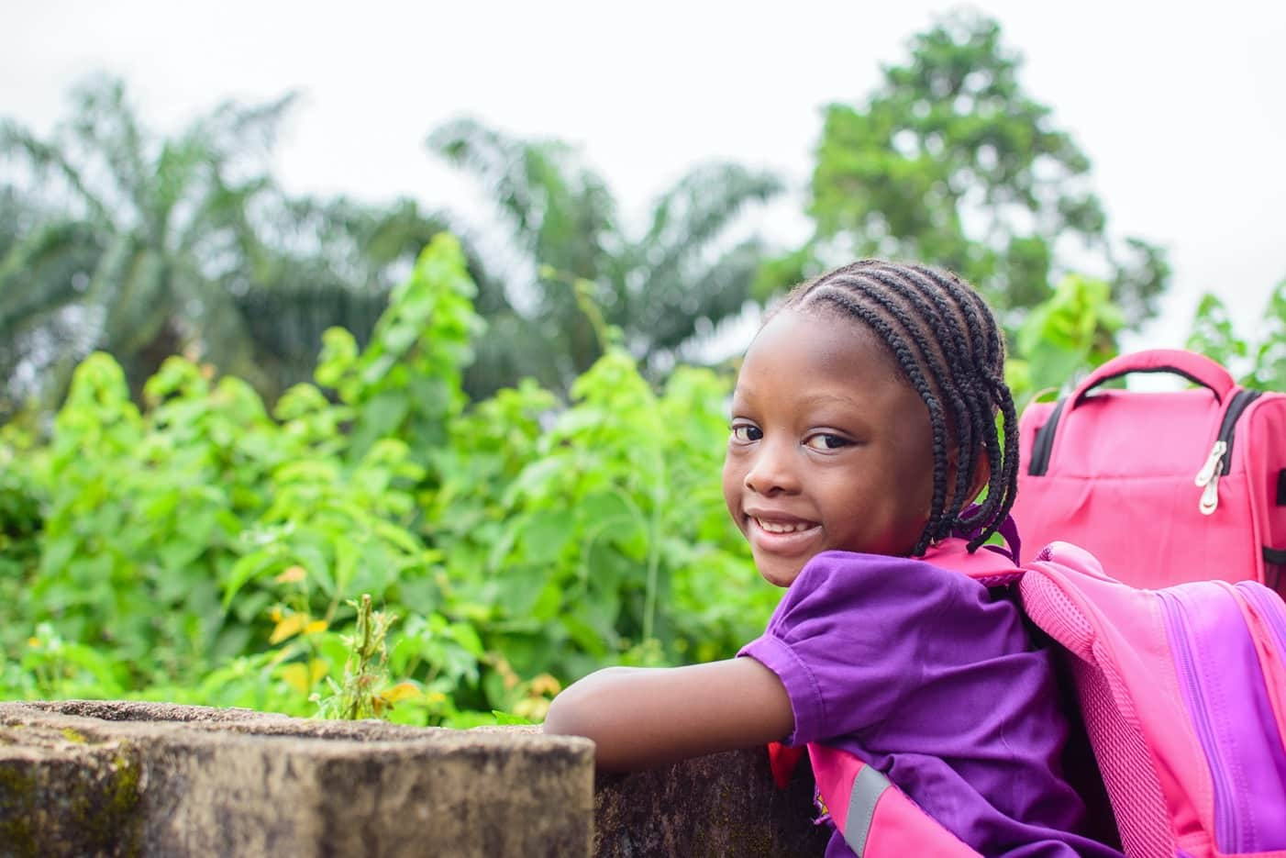
THANK YOU FOR TAKING PART!
childmarriagefree.world

